Slide 1
LA Crime Analytics Dashboard
Phase 2

Slide 2
Out of the Handcuffs: 97% of LA Burglars Are Still Loose
In Los Angeles, a theft or burglary happens every couple of minutes. For every 100 of those crimes — only 3 end in an arrest. The other 97 walk free.

Slide 3
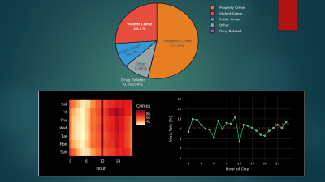
What We Found: The Baseline (phase 1)
53.5% of all crimes = Property Crime, Vehicle Theft = #1
Higher crime areas = lower arrest rates — resource strain is measurable
Male victims outnumber female across ALL crime categories
Police are least effective exactly where they're needed most
The worst problem affects everyone, is everywhere, and is barely policed.

Slide 4
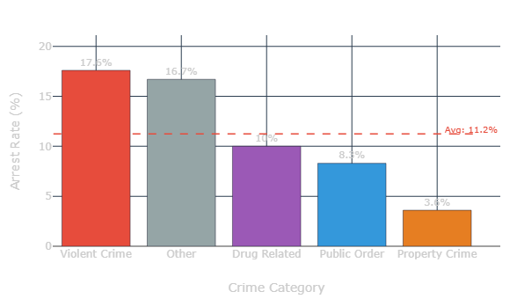
How Bad Is the Arrest Rate? Now We Know Exactly
Property Crime = 3.6% — lowest of all categories
Violent Crime = 17.6% — ~5x higher than property crime
Overall average = 11.2% — dragged down by property crime volume
96 out of 100 property crimes go unpunished. This is not a policing gap — it's a policing collapse.

Slide 5
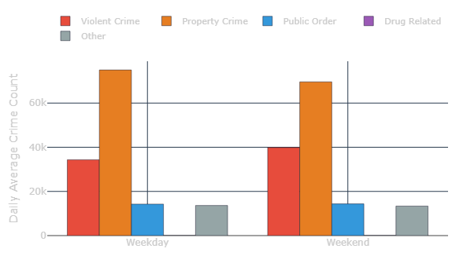
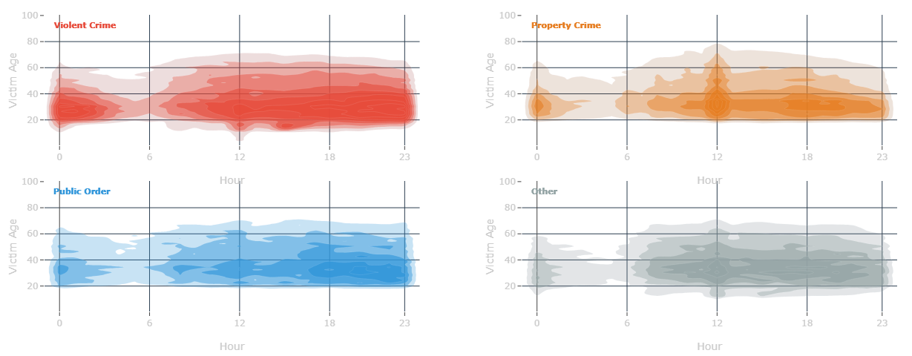
Property and Violent Crime Run on Opposite Clocks
Property crime = weekday problem. Violent crime = weekend problem. They don't share a schedule.
Property crime has one hotspot — noon. Violent crime has one quiet window — before dawn. For 20+ hours a day, it never stops.
One patrol strategy cannot address both. Weekdays need property focus. Weekends need violent crime focus.

Slide 6
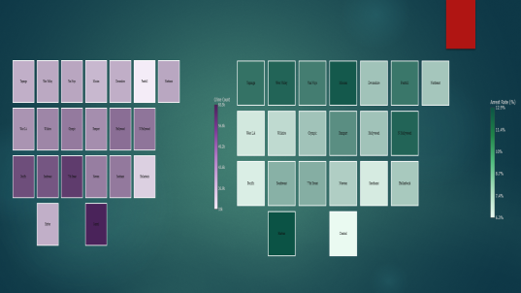
The Overload Effect
Harbor closes 12.9% of cases with the lower crime volume.
Central closes only 6.3% with the higher crime volume.
Overloaded divisions may not fail because of poor policing — they may fail because of overwhelming workload.

Slide 7
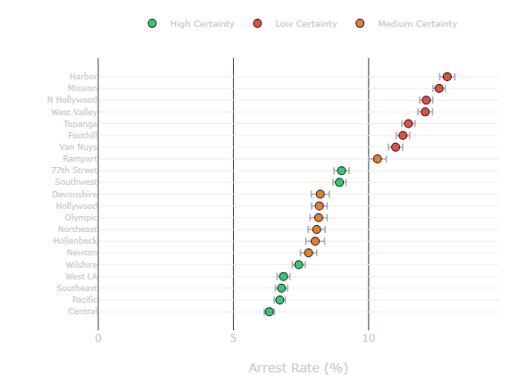
Statistical Certainty Varies by Arrest Rate
Phase 1 found: Higher crime areas = lower arrest rates. Police are least effective where needed most.
High-crime areas (Central, Pacific, Southeast) → low arrest rates → high certainty
Even areas with slightly better rates (77th Street, Southwest ~8%) — still confirmed failures with high certainty
Areas with high arrest rates → low certainty
Failure is certain. Success is not.

Slide 8
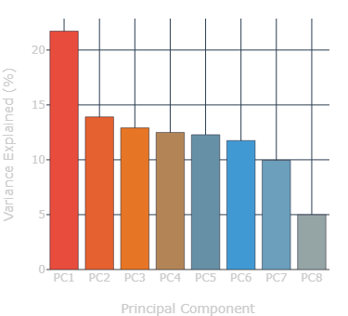
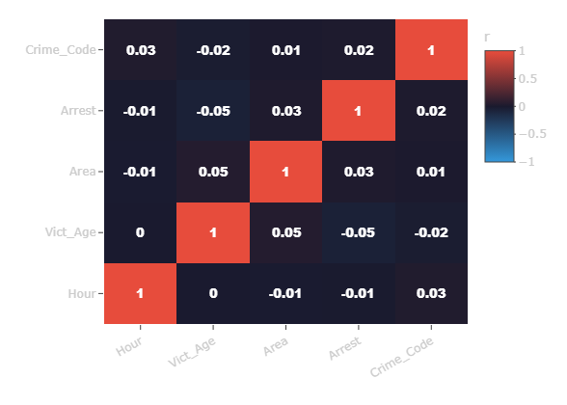
The Data Proves Complexity
All correlations between variables = near zero (r < 0.05)
No single component dominates — PC1 captures only 22%,
requiring all 8 components to explain the full picture
8 components needed — variance spreads equally across all
Every district needs its own strategy. A citywide blanket policy is not just ineffective — it's statistically unjustified.

Slide 9
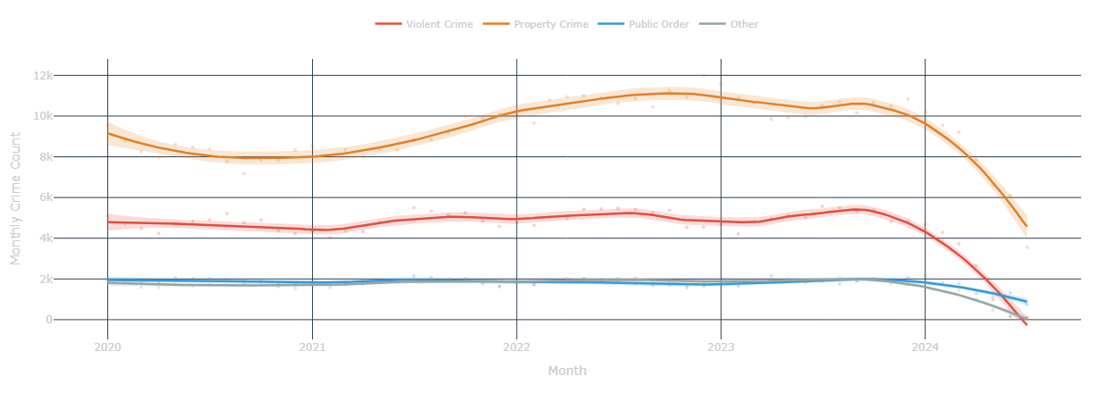
2024 Drop Is a Data Artifact
Every crime category drops simultaneously in late 2024 — that pattern is statistically impossible if it were genuine. This is incomplete data, not real improvement. Policy decisions based on 2024 numbers would be premature.

Slide 10
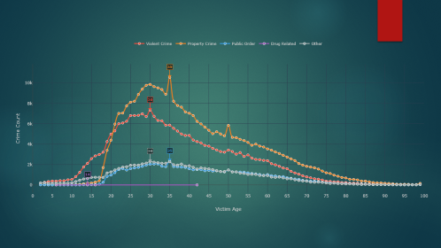
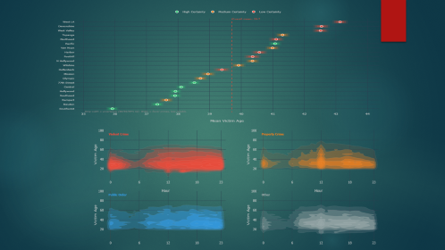
What the Data Recommends
Solution 1 — Targeted Daytime Property Crime Patrol
Property crime peaks at noon on weekdays and targets older victims in western districts.
Pacific confirms this with high statistical certainty — mean victim age 41.2 .
Other western districts show the same trend but with less certainty — supporting indicators, not hard conclusions.
Gap:
Current arrest rate = 3.6%. Reactive uniform patrol wouldn’t be an appropriate action.
Action:
Increase officer presence in commercial areas of western divisions during 9am–2pm on weekdays.
Match the deployment to the crime schedule — not to a uniform citywide timetable.

Slide 11

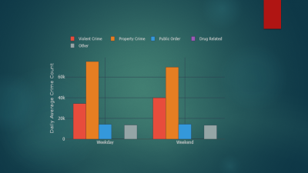
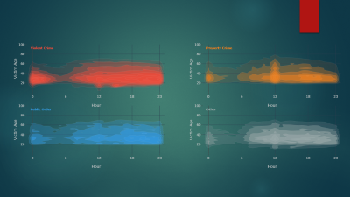
Solution 2 — Permanent Presence for an Unpredictable Crime
Violent crime cannot be scheduled around. The 2D density shows equal activity across nearly all 24 hours. It has only one quiet window — before dawn. And it rises on weekends.
Gap :
Scheduled deployment cannot address a crime with no predictable peak.
Action:
Districts with the younger victim profiles — Newton, Rampart, Southeast, Hollywood — are the most likely violent crime concentration points. Increase evening and weekend presence there. The demographic evidence is statistically confirmed.

Slide 12

Solution 3 — The Overload Fix
Central Division handles 65,500 crimes — the highest in LA — and closes only 6.3% of cases. Harbor handles half that volume and closes 12.9%. The difference is not capability — it may be workload.
Gap :
Overloaded divisions may not fail because officers are ineffective but because the caseload is unsustainable.
Action
Redistribute detective capacity to Central, Pacific, and Southeast specifically for property crime follow-up. Reducing caseload per officer is the intervention — not retraining or restructuring.

Slide 13
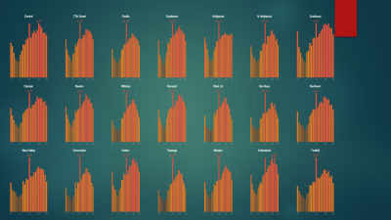
Solution 4 — Division-Specific Scheduling
The correlogram proves no single variable predicts crime across LA. The PCA requires 8 components to explain the full picture. The small multiples show 19 out of 21 divisions peak at noon — but each has its own rhythm.
Gap: A citywide blanket shift schedule is not just inefficient — it is statistically unjustified.
Action : data-driven deployment built around each division's confirmed hourly peak. The data exists for all 21 divisions — it just needs to be used.

Slide 15
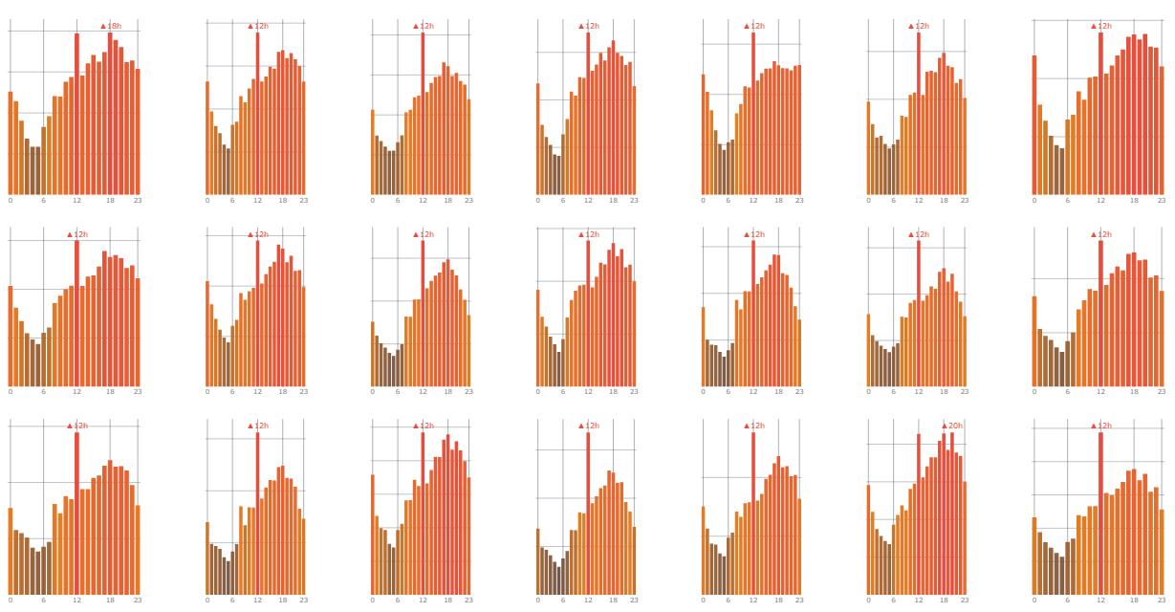

Slide 17
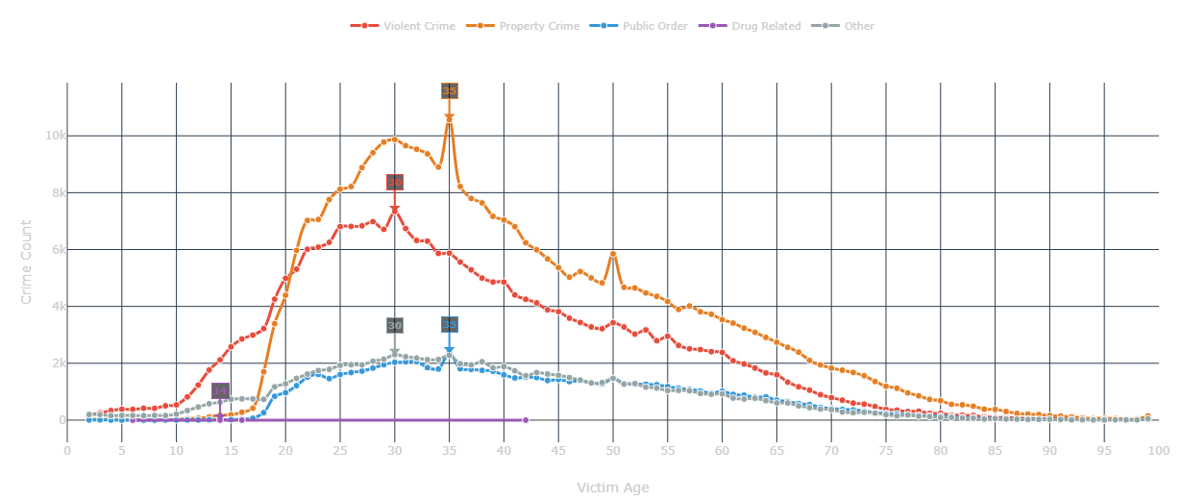

Slide 18
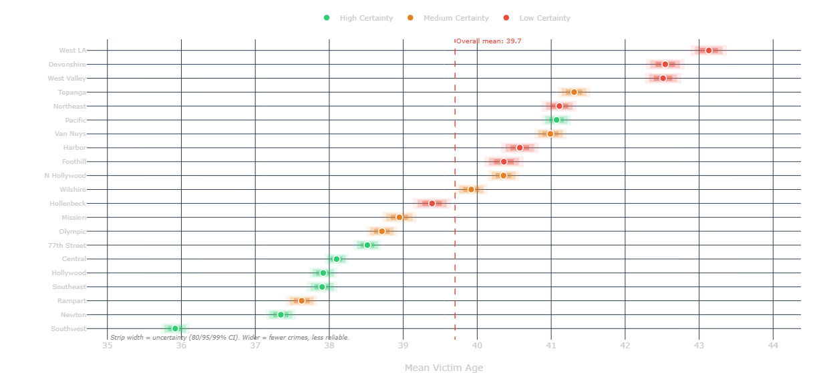

Slide 20
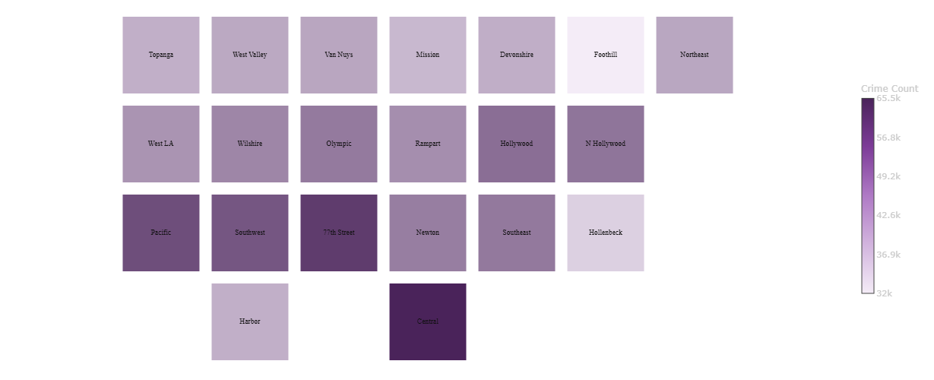
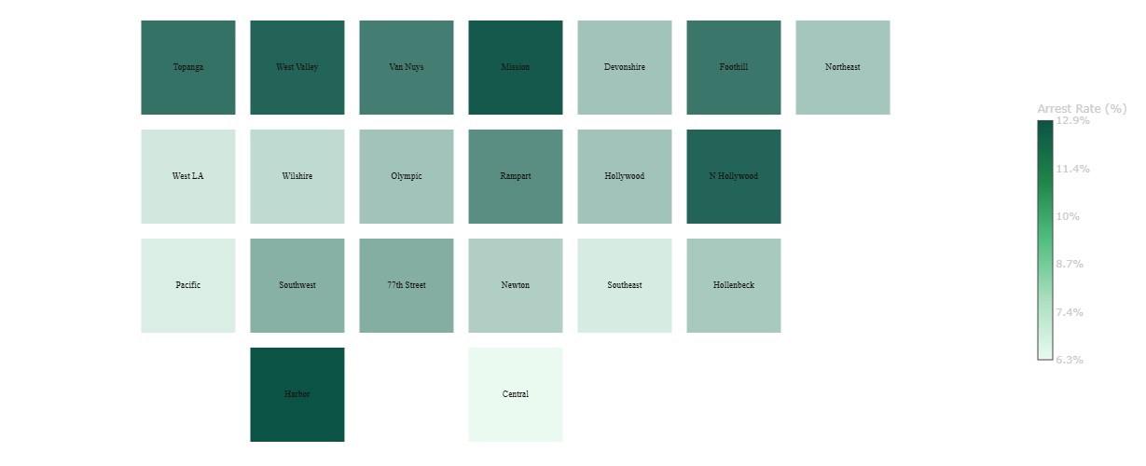

Slide 21
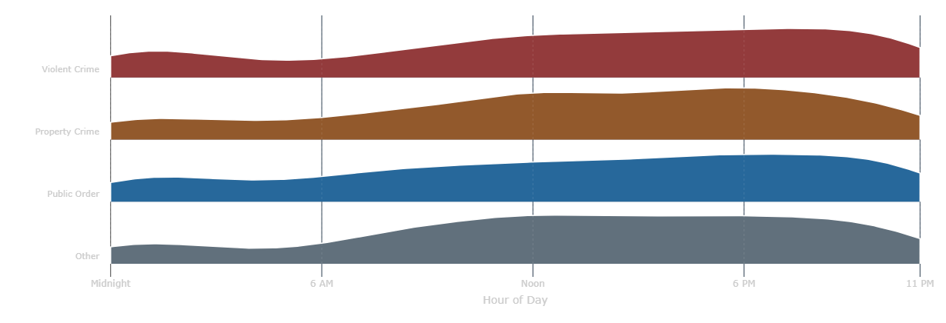

Slide 26
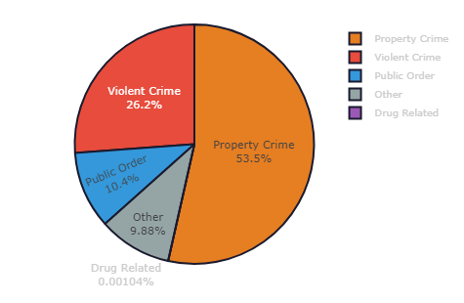
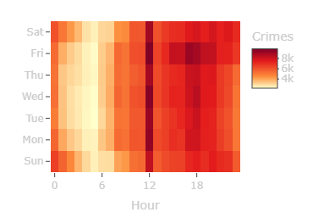
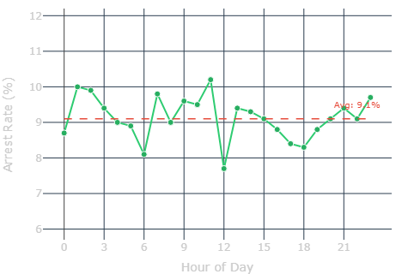

Slide 27
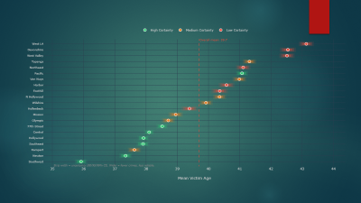
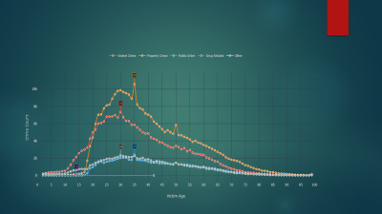
LA Is Two Cities Inside One
Property Crime — peaks at victim age 35, maintains high counts through 40s — targets middle-aged adults
Violent Crime — peaks at age 30, drops faster — concentrates on younger victims Both categories drop sharply after age 50
West LA and Devonshire — highest mean vitamin age — but low certainty (red, wide strips) — not statistically reliable
Southwest and Newton — lowest mean vitamin age — high certainty (green, narrow strips) — statistically reliable
The older the mean victim age, the less reliable the estimate. The younger the mean vitamin age, the more reliable
(Statistically, we can trust the younger-area findings. The older-area findings are too uncertain to act on.)

